Slide 1
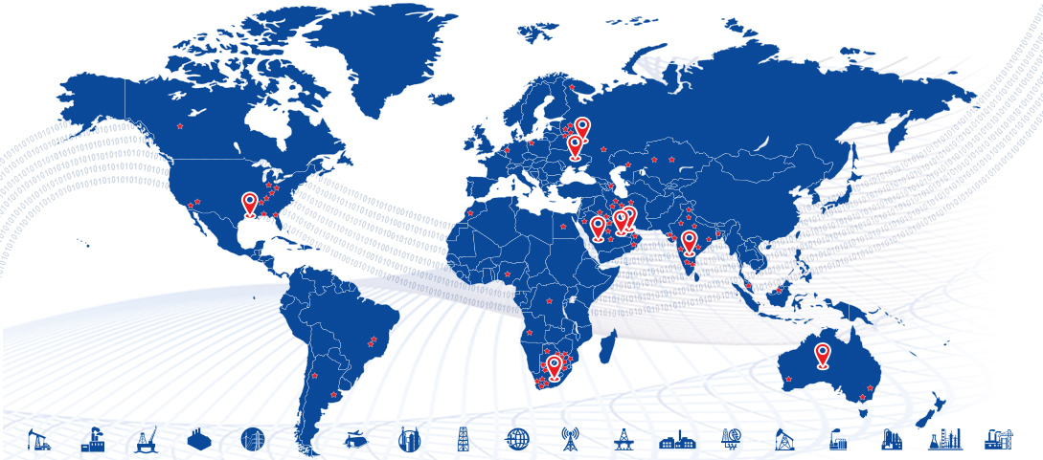



Material Cataloguing & Codification for Yanbu WTS WRFP230075 Technical Proposal

Slide 2
Introduction
Dear Sir,
Date: 14th July, 2024
First, we would like to thank you for the opportunity granted to PiLog to submit a response to the request from WTTCO for the provisioning of SPIR material codification & cataloguing services
This document contains a Technical proposal for your kind reference.
We shall remain at your disposal should you require any additional information.
We look forward to hearing from you and we assure of our utmost cooperation, at all times.
Sincerely,
Umar Farooq
Sales Head

Slide 3


Contents
Introduction
PiLog Group Overview and Clientele
PiLog’s Industry Experience
PiLog Recommended Solution & Approach
Master Data Strategy
Data cataloguing & Standardization With Examples
Project Approach & Methodology
Project Deliverables

Slide 4



PiLog - The Digital Transformation Company
Established in 1996, PiLog Group is a global group of independent companies, specializing in Quality Data and Digital Governance & Analytical solutions supporting multiple data domains in a variety of industries all over the globe. The PiLog solutions are state of the art, focused on creating a common business language and managing the rules for the creation of high quality, multilingual terminology using Machine Learning, Artificial Intelligence technologies & human-augmented algorithms for our customers who are eager to transform their businesses digitally.
PiLog provides exclusive technical dictionaries, industrial libraries with content repositories that are the culmination of research, development, and execution over the past twenty years embedded into the platform of PiLog – Data Quality Hub. All our methodologies, processes, solutions are compliant with international standards for delivering seamless systematic integration of content into various platforms and ERPs such as SAP, S4 HANA, Oracle ERP Cloud, Maximo & MS Dynamics, etc.
PiLog India Private Limited, India
PiLog India Labs (R&D)
PiLog Technology Solutions, Abu Dhabi, UAE
PiLog Pty Ltd, Dubai, UAE
PiLog Saudi International, KSA
PiLog Innovative Solutions, Qatar
PiLog Inc, USA
PiLog Pty Ltd, RSA

Slide 5





























































PiLog’s Industry Experience
Mining & Metals
Manufacturing
Aerospace & Defense
Airports & Aviation
Petro-Chemical & Chemicals
Oil & Gas
Insurance
© PiLog
www.piloggroup.com
5

Slide 6













































PiLog’s Industry Experience
FMCG
Utilities
Marine
Glass & packaging
Iron & Steel
Transport
Textiles
Nuclear
Telecommunication
Entertainment
Cement
Construction
Smart City
Pharmaceuticals
© PiLog
www.piloggroup.com
6

Slide 7





PiLog’s Industry Experience
FMCG
Utilities
Marine
Iron & Steel
Transport
Textiles
Nuclear
Telecommunication
Entertainment
Cement
Construction
Smart City
Pharmaceuticals
© PiLog
www.piloggroup.com
7

Slide 8








Key references of SPIR cataloguing Projects
Phase 1 Data Health Assessment & Material Criticality Analysis
Outcome:
No Consumption Value of Inventory Growing from 21.3 MSAR to 75.9 MSAR in past 5 and 10 years
~ 10K Duplicate elimination with potential saving of ~ 43-44MSARor 16.6% of current inventory value
Phas2 (Ongoing)
Data Cleansing of 20K critical MRO items
Inventory Parameters Optimization
Material Criticality Re-ranking (MCR)
Data Cleansing of 182 SPIRs with 7076-line items
SPIR Registration with the associated SPDP Requirements and Attachments
SPIR and Document Control
SPIR Approval Workflow
Detect and Resolve duplicate items
Classification, Standardization & Enrichment
Structured Short & Long Descriptions Generation
Data Cleansing of 120 SPIRs with 8000-line items
SPIR Registration with the associated SPDP Requirements and Attachments
SPIR Document Control & Approval Workflow
Detect and Resolve duplicate items
Classification, Standardization & Enrichment
Structured Short & Long Descriptions Generation
Data Cleansing of 165 SPIRs with 6,651-line items
SPIR Registration with the associated SPDP Requirements and Attachments
SPIR Document Control & Approval Workflow
Detect and Resolve duplicate items
Classification, Standardization & Enrichment
Structured Short & Long Descriptions Generation
Data Cleansing of 47 SPIRs with 15,334-line items
SPIR Registration with the associated SPDP Requirements and Attachments
SPIR and Document Control
SPIR Approval Workflow
Detect and Resolve duplicate items
Classification, Standardization & Enrichment
Structured Short & Long Descriptions Generation
Data Cleansing of 28 SPIRs with 1500-line items
SPIR Registration with the associated SPDP Requirements and Attachments
SPIR and Document Control
SPIR Approval Workflow
Detect and Resolve duplicate items
Classification, Standardization & Enrichment
Structured Short & Long Descriptions Generation
SPIR Registration with the associated SPDP Requirements and Attachments
SPIR and Document Control
SPIR Approval Workflow
Detect and Resolve duplicate items
Classification, Standardization & Enrichment
Structured Short & Long Descriptions Generation
Data Cleansing of 21,476-line items
SPIR Registration with the associated SPDP Requirements and Attachments
SPIR and Document Control
SPIR Approval Workflow
Detect and Resolve duplicate items
Classification, Standardization & Enrichment
Structured Short & Long Descriptions Generation
PiLog

Slide 9
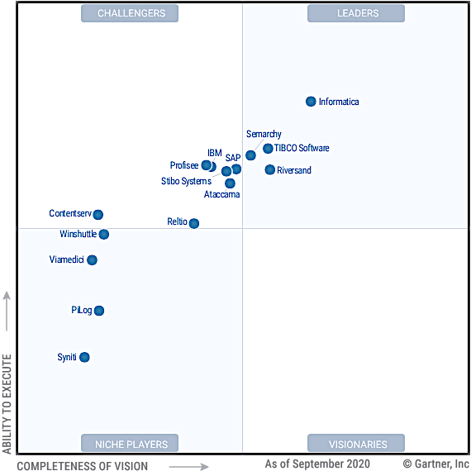
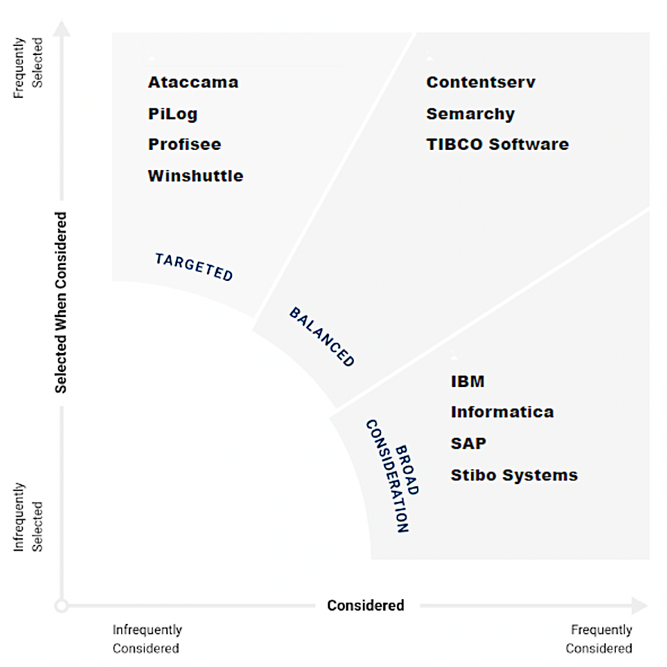
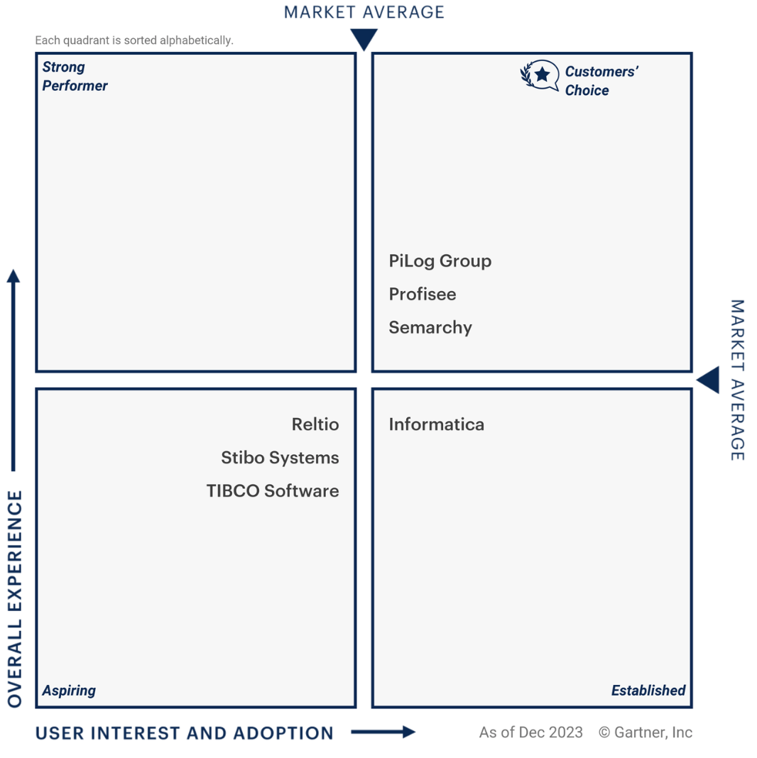
PiLog has been recognized and mentioned in prominent advisories and research organizations
Gartner Peer Insights “Voice of the Customer” “Master Data Management Solutions “ Customers’ Choice Awards 2024
PiLog named as a “Niche Player” in the 2021
Gartner’s Magic Quadrant for
“Master Data Management Solutions”
PiLog named in Gartner’s Peer Insights Vendor Spectrum 2021 for “Master Data Management Solutions”
Gartner Recognitions

Slide 10
Value Engineering Solutions
Data Quality HUB
Enterprise Data Strategy
Digital Advisory
EAM Objects: Floc, Eqpt, eBoM, fBoM, MI, TL, MP…
Digital Strategy
eSPIR Management
Inventory Optimization
Asset Lifecycle Mgmt.
Supply Chain Mgmt.
Services & Contracts Management
Plant Maintenance Strategy
Value Engineering Portfolio
Financial Assets Management
S2P, P2I, S2C, A2R, O2C: Business Process Optimization
Facilities Management
Digital Transformation
MDM: MM, PM, SM, AM, VM, CM, EM
Data Governance & Analytics
Business Partner Lifecycle Mgmt.
Single Version of Truth
BP Data Migration, Reconciliation and Consolidation
Integration, Sync, Orchestration, Business Services
BP Portal & Orchestration
Data Quality Mgmt.
Descriptive, Prescriptive & Predictive Analytics
BP Data Regulatory, Statutory Compliance & Governance
On-Cloud & On-Premise
BP Data Classification, Categorization, Industry Clusters
Data Quality Compliance, Maturity Audit
ISO: Meta Data, Taxonomy, Ontologies Assessment
Data Cleansing, Cataloguing & Enrichment
PiLog
www.piloggroup.com
10

Slide 11
Key Apprehensions of Business Leaders…
“Transforming Supply Chain – Sourcing, Procurement, Inventory, Business Partner Collaboration …”
“Organization Asset Life Cycle Management and Maintenance Maturity improved…”
“Seamless Data Migration & Transformation, setting roadmap for Digital Analytics & Transformation…”
“With ~ 70 to 75% average organizational costs are associated with materials & services SCM Processes with prime mantra
A DOLLAR SAVED IS DOLLAR EARNED”
CPO’s and CFO’s self-reflect the opportunities… WHERE & HOW!!!
“With ZERO appetite for asset replacement in aging industries, industry leaders nightmare is enduring performance from old war horses”
Prominent Plant Operations leaders self-reflect the challenges… WHY & WHAT!!!
“With most of the organizations looking at IT Asset & Platform, data consolidation & analytics - Look out for robust Digital Roadmap”
CIO’s and CEO’s self-reflect WHEN & HOW we can have impactful Transformation!!!
Spend & Partner performance visibility…
Real-Time Inventory hoarding information…
Confidence on partnership & value generation…
Achieve industry benchmarks - KPI’s & KRA’s…
Lower Total Cost of Ownership...
Asset performance visibility…
Maintenance Maturity Model Vs. Benchmark…
Confidence on maintenance operations…
Achieve industry benchmarks - KPI’s & KRA’s…
Lowering Total Cost of Ownership...
Seamless Data Migration…
Master Data Transformation and Cleansing as per ISO, UNSPSC, NATO, KKS, DUNS, IATA etc..
Digital Transformation & Predictive Analytics…
Lowering Total Cost of Ownership...
“As renowned partner of choice, we are here to assist in journey to excel”
PiLog
www.piloggroup.com

Slide 12

Scope of Services and key metrics
PiLog’s understanding of scope of services for Data Cataloguing/Codification using the best indutry practices

Slide 13
Scope of Services
The scope of this project is as below
Site survey and data collection
Visit the site/s to understand the data and required documents and create know how of the requirement.
Collect all the document (drawings, O&M manuals, data sheets, name plates, … etc) prior the starting.
Conduct the workshops with the WTTCO team and set all project implementation plan.
2. Data cataloguing and cleansing.
3. Cataloguing and standardize the data as per the requirements and proposed format.
comply with submitting forms for each department separately (mechanical, electrical, instrumentation and control) according to the attached Excel file. (approx 9,500 item)
reply to any clarification and editing required from supply chain management to upload the document smoothly.
4. deploying the resources on-site to carry-out project coordination and support the on-going execution.
PiLog has high level solution maps for seamless execution of program in due consideration of WTTCO’s Business Objectives, Challanges and requirements

Slide 14
PiLog Recommended Solution & Approach
PiLog’s optimized solution management is aimed at Material Master Data Standardization & Enrichment for improving overall organizational effectiveness!!!

Slide 15
Master Data Management – Organizational Strategy
3
Business Performance
1
Consolidation
Establish the Digital Analytics platform
Design & Build the InfoGraphics for CXOs
Evaluate the performance of organization based on data insights (KPIs, SLAs etc)
Evaluate the benefits & establish the numbers
Acquire/Collect the data from various sources/systems/landscapes
Standardize / Harmonize & enrich the datasets using Industry-specific standards & taxonomies
Perform Physical Stock Verification where required
Establish the Single version of truth
Design & Establish the intelligent processes to address the newly available data
2
Governance
Transform the processes to adapt the systematic data flow
Assess, Monitor & Improve the Data quality
Establish centralized teams with strategic objectives for various process
Enforce the governance principles across the organization
Notes:
Change slide

Slide 16
Data Quality Standards for Material Master…
Data Portability
ISO 8000
Data Portability
Data Requirement
ISO 8000-110
Class/Concept Definition, unique identifier
Quality data is portable data; it is independent of the software application
Data Terminology & Localization
PPO-OTD: ISO 8000-110
Common Business Language
Data Classification
ISO 22745
Linking PPO class to classification (UNSPSC)
Provenance – Traceable History at record level
Data Traceability
ISO 8000-120
Property/Concept Definition, unique identifier
Business Requirements
Multi-lingual
Linking PPO class to classification (spend tree)
Technical Dictionaries & Exchange of Characteristics Data
ISO 22745
Technical Dictionaries
Exchange of characteristics data in xml format
Owner of the data created
ISO 8000
Master Data Quality
ISO 22745
Open Technical Dictionaries
ISO 29002
Exchange of Characteristics data

Slide 17
PiLog Preferred Ontology PPO (Taxonomy Standard) & Business Benefits…
PiLog through out the 25 years of experience in master data solutions across different industries have developed PiLog Preferred Ontology (PPO) which is a Technical Dictionary that complies with the ISO 8000 standard. The PPO is a best defined industry specific dictionary covering all industry verticals such as Petrochemical, Iron & Steel, Oil & Gas, Cement, Transport, Utilities, Retail etc.
Each PPO class is a combination of object-qualifier or noun-modifier, which in turn is linked to either a material group or UNSPSC code depending on the customer requirement for the spend analysis. Each class in the PPO dictionary will have a set of properties/attributes with definition, abbreviation, mandatory flag and property sequence.
Business Benefits
Uniformity in Business Communication
Accurate & Cost Effective Sourcing
Unambiguous Identification
Consistent Sales & Purchase Order Descriptions
Potential Duplicate Identification
Visibility of Spend
Optimized Inventory & Supply-Chain Management
Standardized processes
PPO Consists of
Class
Characteristics
Characteristic Sequence
Mandatory Indicator
Class Definition
Characteristic Definition
Class Abbreviation
Characteristic Abbreviation
Description Generation Rules
Standard Values
Standard Value Abbreviations
PPO
(PiLog Preferred Ontology)
PRO
(Ontology of all PiLog Clients)
OTD Registry
(Over 1.4
million concepts)
OTD: Open Technical Dictionary
CPO
(Client/Corporate Preferred Ontology)
ISO 22745 & ISO 8000 Complaint

Slide 18
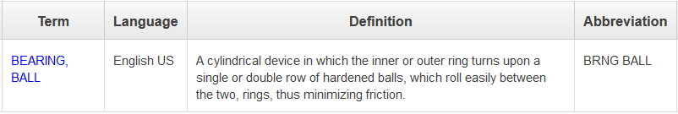
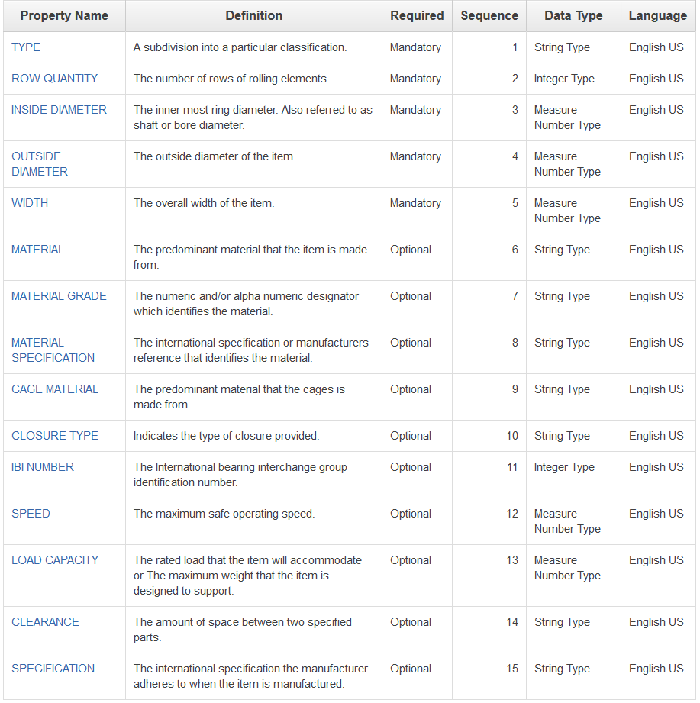

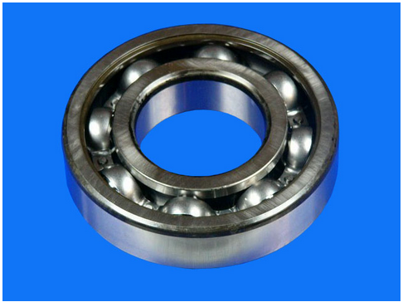
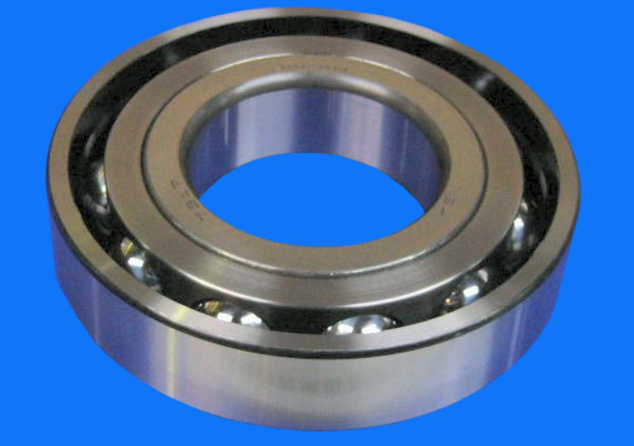
PPO (PiLog Preferred Ontology) Examples…
CSAPÁGY, GOLYÓ | Hungarian HU
LOŽISKO, KULIČKOVÉ | Czech EU
ベアリング、ボール | Japanese JP
RULMENT CU BILE | Romanian RO
ROULEMENT À BILLES | French CA
ROLAMENTO, ESFERAS | Portuguese EU
滚珠轴承 | Chinese CN
베어링, 볼 | Korean KR
COJINETE, BOLA | Spanish MX
LAGER, KULE | Norwegian NO

Slide 19








Envisaged Simplified Solution Architecture for WTTCO SPIR cataloguing Services..
Source Systems
WTTCO
PiLog
Target
Systems
User Interface (English)
API / Webservices
Https
FTP
Offline Extract & Load
FTP
Offline Extract & Load
SAP S/4 HANA
SAP S/4 HANA
iSPIR Solution
Offline Data (.xls, .csv etc.)
Spare parts Interchangeability Records
Offline Data (.xls, .csv etc.)
Syndication
PiLog
www.piloggroup.com
19

Slide 20
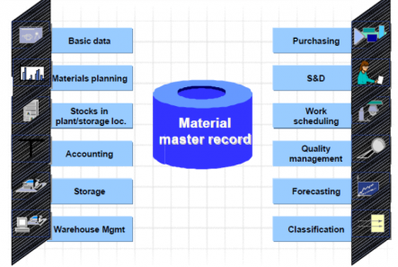


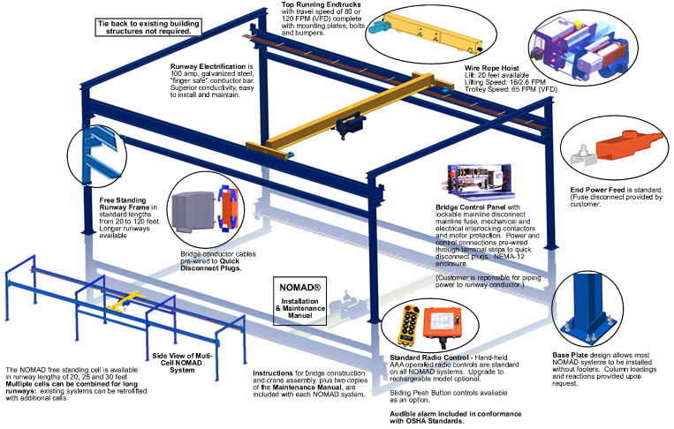
Process of accomplishing Item / Material Master objects (Sample Model)...
1
Item / Material Master Cleansing Services (As per ISO 8000 Data Standard)
2
Plant Walk down for acquiring missing information Materials/data extraction
Source Information
Data Extracted from Manuals, Data Sheets, Catalogues, ERP Systems
4
Prepare the Final Master Data Set to be uploaded to SAP
3
SPIR sheets Cataloguing & Standardisation
PiLog
www.piloggroup.com

Slide 21
Single Version of Truth – Data Cleansing
Data Acquisition from ERP
Extract & Validate Drawings data
Assign a Class (PPO)
Extract & Validate Reference Data
Extract & populate property values
Populate & Validate Material Groups
Standardize & Abbreviate values
Perform Physical Verification
Generate Structured Descriptions
Generate & Confirm Potential Duplicates
Approve & Upload to ERP
Single Version of Truth
Notes:
21

Slide 22









Solution Architecture Framework
Data Source
Data Staging and Test Environment
Auto Structure Algorithms
Repository Records (PPR) & Data Libraries
Cleanse
Transformation
Extract
Master Data Project
(Staging Area)
Preparation of final Catalogued SPIR data in unloadable format
Legacy
Extract
Business Rules
Enrich & Transform
Cleanse
Standardization
Data Quality Review
De-Duplication
Industry Standards
Standard Descriptions
Performance Analysis
Dashboards and Business Reporting
Data Health Assessment

Slide 23
Spares Data Acquisition – The Methodology
Vendors
EPC 1
EPC 2
EPC 3
EPC n
Project Document Control Team
SPDP
- Document Control
- Eng. Documents
- SPIR
- Others
Data Harmonization Team
Catalogue Spares
Material Management Team
Material Standardizations
And Management
ERP
Materials Standardisation and Management
Materials Standardisation and Management
Materials Standardisation and Management
ERP
Materials Standardisation and Management

Slide 24

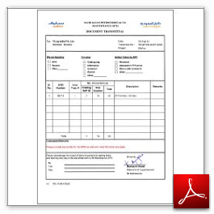

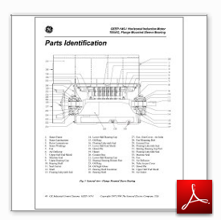



SPIR Management – Electronic Spare Parts Interchangeability Record
Plant (Business Unit)
SPDP – Spare Parts Data Package
Engineering Package
Project-1
Project-2
EPC-1
EPC-2
Vendor-1
SPIR-n to m
Vendor-n
SPIR-p to q
Transmittal
SPIR Sheet(s)
Supporting Documents
www.piloggroup.com

Slide 25
PiLog SPIR Management – Business Benefits
Client Resource Cost reductions
Supplier/Contractor registers spares online
Electronic workflow cuts time to process
Interface to ERP cuts registration time
Spares linked to Plant Equipment cuts searching time of Plant Maintenance personnel
Procurement Cost reductions
Electronic verification of spares against existing Catalogue allows reduction in procurement quantities
Allows for inventory optimization that cuts replenishment costs.
Cross referencing of spares allows for optimization of preferred Vendors, improving bargaining power
If Plant Maintenance find spares due to improved descriptions and links, reduction in ad-hoc purchasing can be expected.
Improved spend analysis allows for Procurement to concentrate on problem processes and Vendors
Warehousing Cost reductions
Duplicate Resolution optimizes warehouse layout and size
Warehouse personnel spend less time searching for spares, hence become more productive
Identification of common spares between plants can cut possible delivery time on critical spares
Plant Maintenance Cost reductions
Less downtime due to spares unavailability

Slide 26
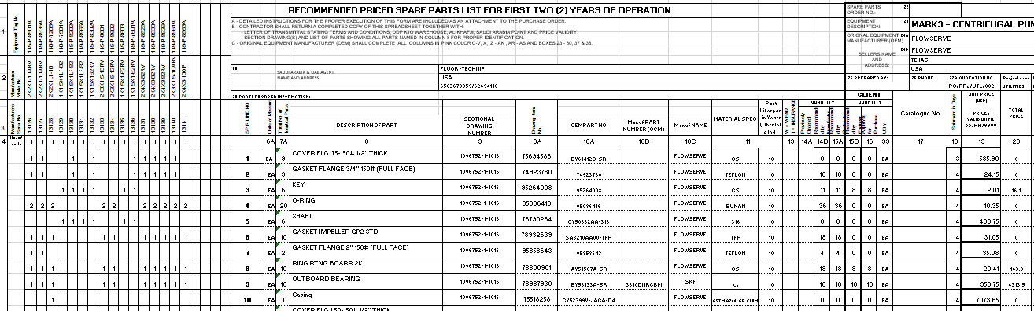
SPIR. Management – SPIR Template
5
1
3
2
6
4
1. Parent Equipment Tag/Model/Serial Number
2. Installed number of Spares
3. Spare Part Description
4. 2 Years Recommended Spares
5. Equipment Supplier & Manufacturer details
6. Price

Slide 27
PiLog e-SPIR Functionality (Proposed)
Organization and Project Setup with all the Related Participants
SPIR Registration with the associated SPDP Requirements and Attachments
SPIR Approval process and workflow
SPIR Template Upload and Extraction
Detect and Resolve duplicate/Mapped items
Cataloguing, Classification and Standardization of Equipment and Spares
Creating of FLOC
Equipment Registration during the SPIR Upload.
Linking of Equipment to FLOC
Equipment BoM creation during the SPIR Upload
MM (Spares) and PM (Equipment, Equipment BoM, FLOC) data integration with SAP

Slide 28
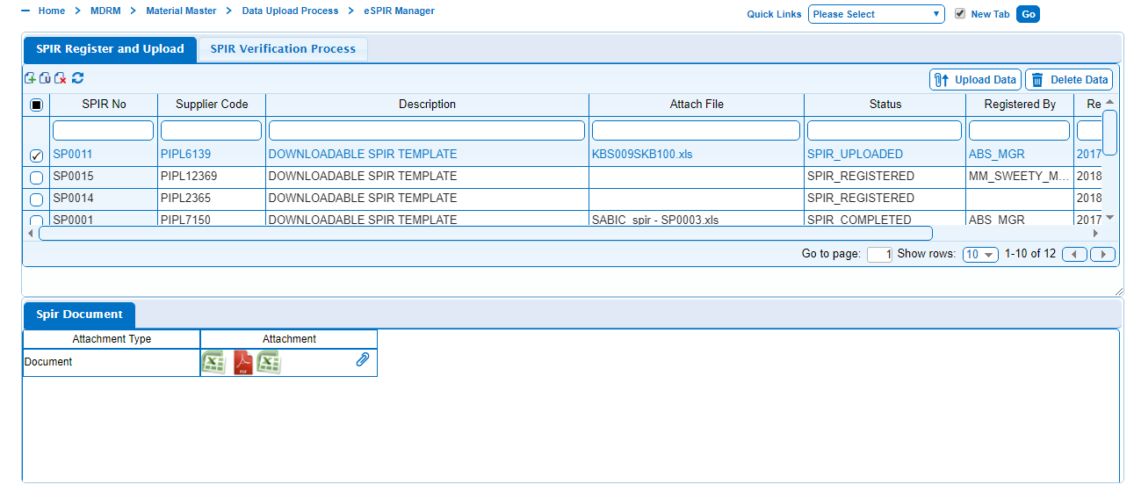
PiLog iSPIR Management – SPIR Registration

Slide 29
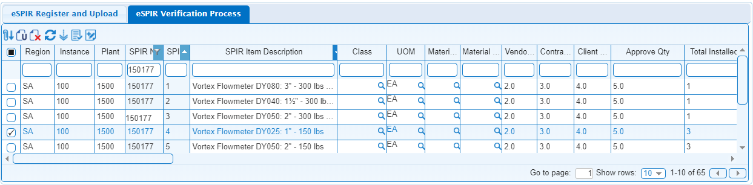
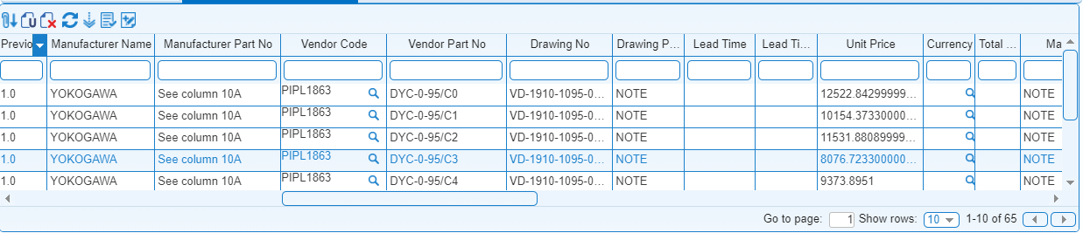
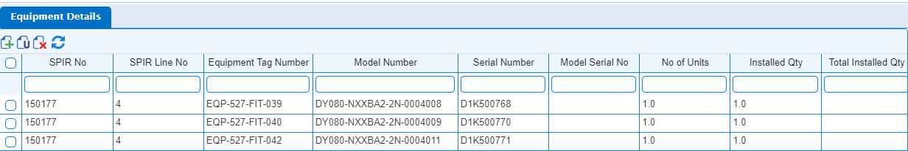
PiLog iSPIR Management – SPIR Extraction

Slide 30
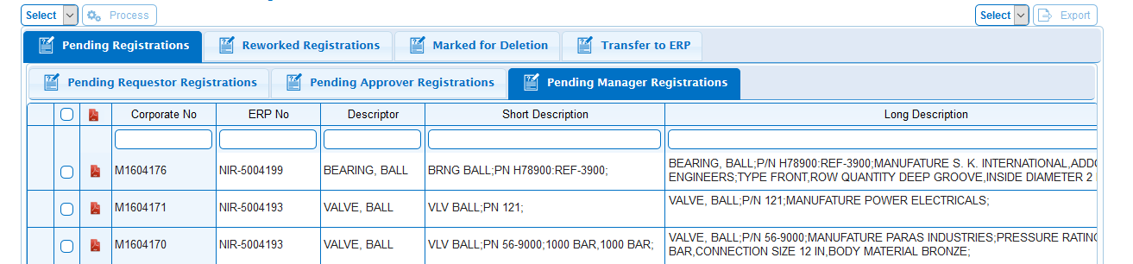
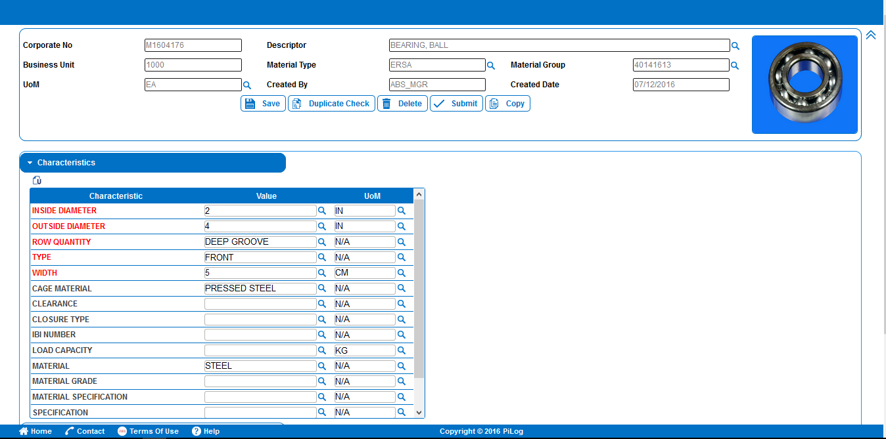
PiLog iSPIR Management – Spares Registration and Cataloguing

Slide 31
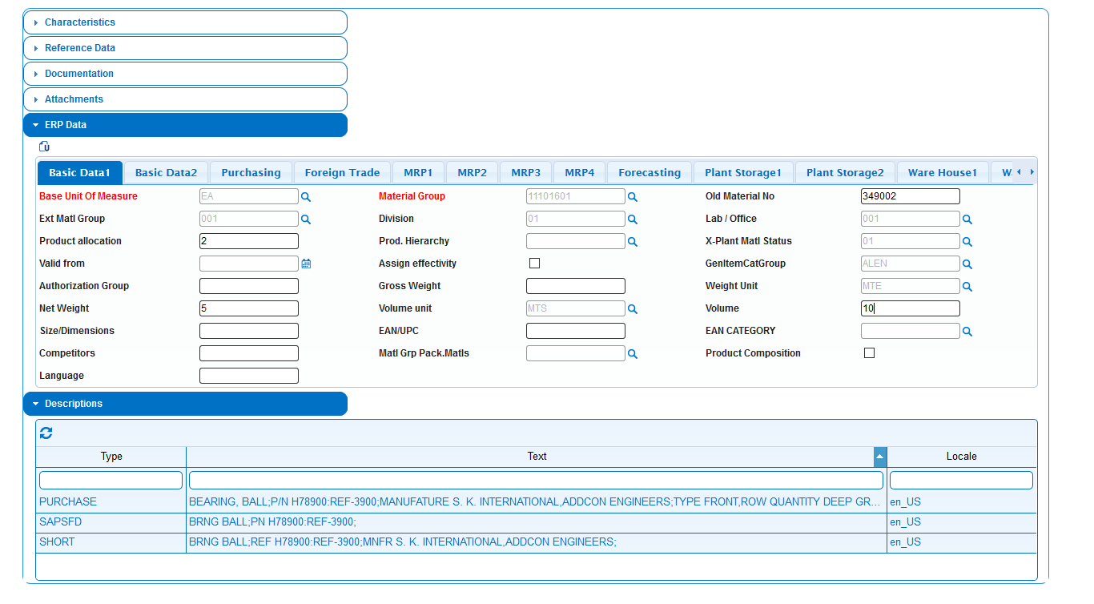
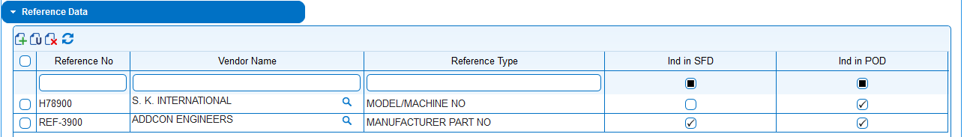
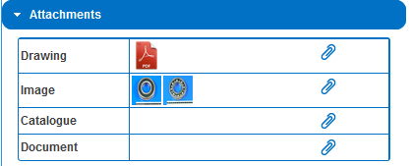
PiLog iSPIR Management – Spares Registration and Cataloguing

Slide 32
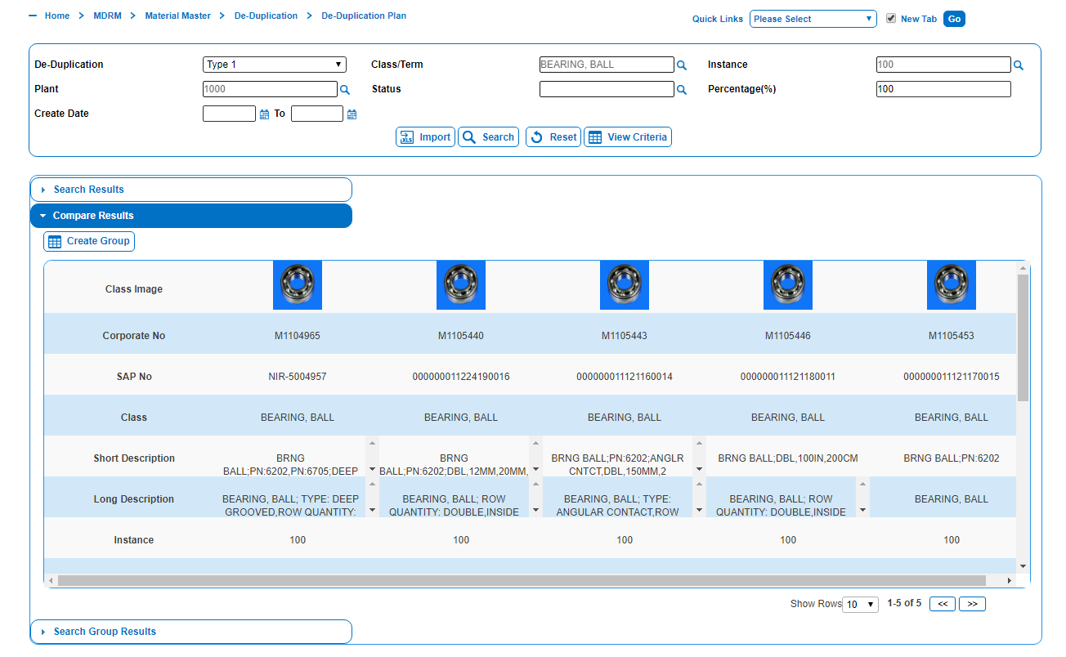
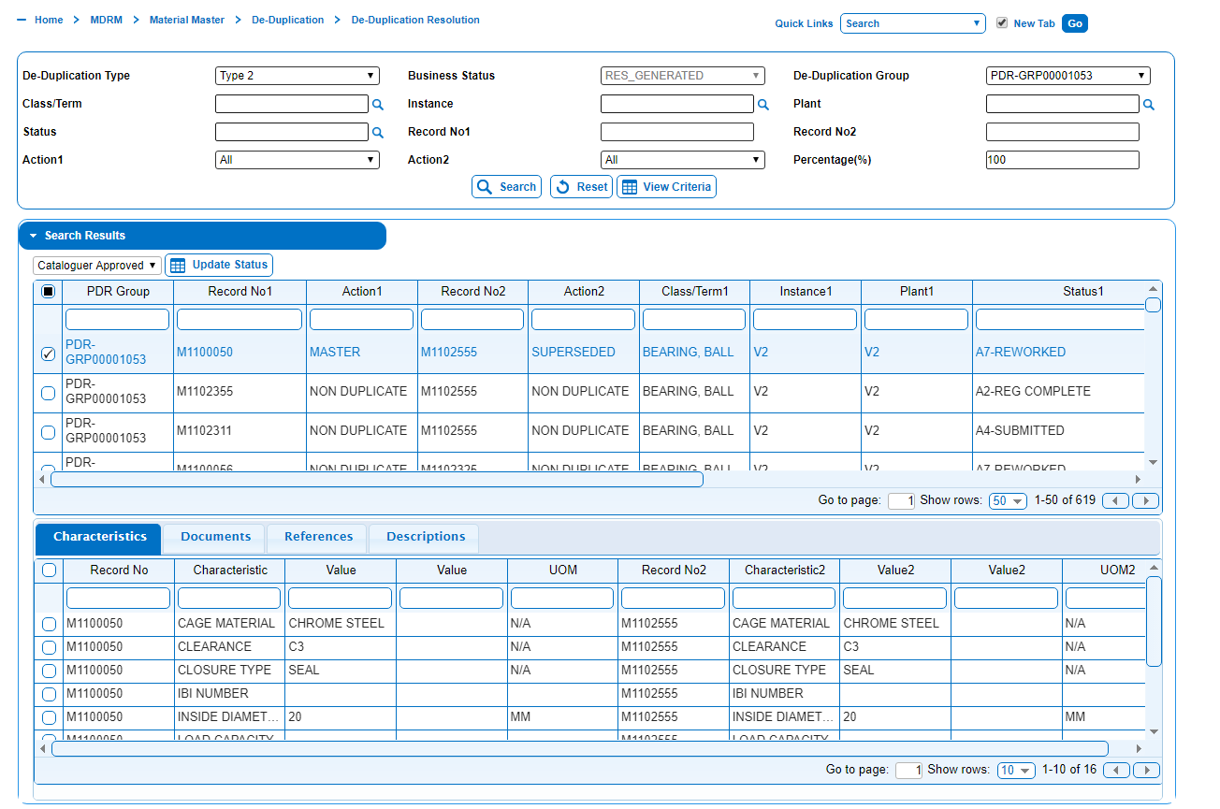
PiLog iSPIR Management – Duplicate Resolution

Slide 33
Example: Master Data Template
VALVE, BALL | Property Value | Value UOM
SIZE | 1/4 | IN
PRESSURE RATING | CL 150 | N/A
BODY MATERIAL | CARBON STEEL | N/A
CONNECTION TYPE | NPT | N/A
OPERATED | WHEEL | N/A
PORT TYPE | FULL BORE | N/A
TRIM | BALL: SS 316, STEM: SS 316 | N/A
TYPE | LOW PRESSURE | N/A
MATERIAL SPECIFICATION | ASTM A105 | N/A
MATERIAL GRADE | B | N/A
LINING MATERIAL | TEFLON | N/A
SOFTGOODS | SEAL: NBR, PACKING: GRAFOIL | N/A
FACE TO FACE LENGTH | 150 | MM
TEMPERATURE RANGE | -30 TO 100 | DEG C
DUTY | HEAVY | N/A
APPLICATION | CENTRIFUGAL PUMP | N/A
MEDIUM | WATER | N/A
FLOW RATE | 16 | L/MIN
MOUNTING METHOD |  | N/A
SPECIAL FEATURES |  | N/A
SPECIFICATION |  | N/A
PiLog
Notes:
33

Slide 34

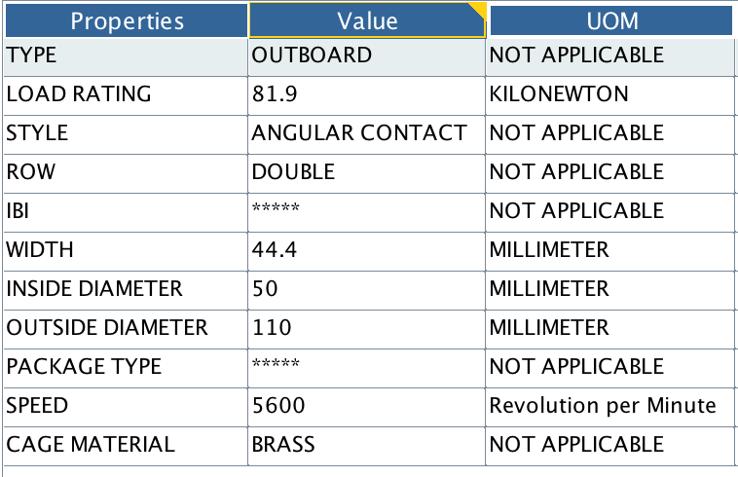
Material Harmonization and Cataloguing Outcome (Example….)
Assign Class
Class Name: BEARING, BALL
Original Description: OUTBOARD BEARING CS 3310DNRCBM SKF
Populate Properties
Catalogued Short Description (40 Char)
BEARING,BL;OBRD,DBL,50MM,110MM,4.4MM,BRS
Catalogued Long Description
BEARING, BALL; TYPE: OUTBOARD, ROW: DOUBLE, INSIDE DIAMETER: 50 MILLIMETER, OUTSIDE DIAMETER: 110 MILLIMETER, WIDTH: 44.4 MILLIMETER, CAGE MATERIAL: BRASS, STYLE: ANGULAR CONTACT, SPEED: 5600 REVOLUTION PER MINUTE, LOAD RATING: 81.9 KILONEWTON, MATERIAL: CARBON STEEL, MNFR PART NO: 3310DNRCBM MNFR SKF
PART NUMBER: 3310DNRCBM MANUFACTURER: NSK
Notes:
Change to 40 Chars

Slide 35
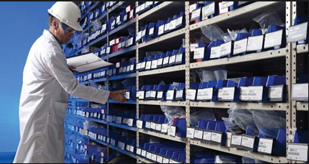
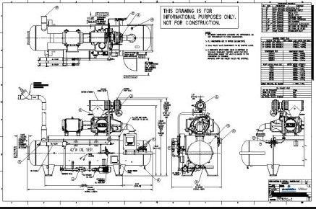



Material Master – Enrichment example…
Enrichment is the process of sourcing additional information about a material item from physical inspection or external sources like the internet, manufacturer catalogues or engineering drawings.
Item Number: 123456
Current Catalogue Description
BRG , NSK PN: 6206ZZC3 62*16 , 11979 FOR MOTOR
PiLog Data Repository
(10 Million Records)
Catalogued
BEARING, BALL:
TYPE: DEEP GROOVE
ROW: SINGLE
INSIDE DIAMETER: 30MM
OUTSIDE DIAMETER: 62MM
WIDTH: 16MM
CAGE MATERIAL: PRESSED STEEL
CLOSURE TYPE: SHEILDED
IBI: 11979
APPLICATION: MOTOR
BEARING, BALL:
OUTSIDE DIAMETER: 62MM
WIDTH: 16MM
IBI: 11979
APPLICATION: MOTOR
Enriched
P/N: 6206ZZC3 NSK
P/N: 6206ZZC3
Manufacturer: NSK

Slide 36
Sample Catalogued Data (Generation of SAP Short Descriptions)
S.no | Source Description ( Short Text) | PiLog Catalogued Short Description
1 | CONTACTOR;SCHNEIDER ELECTRIC;LC1 D80G7 | CONTCTR,PN:LC1D80G7,80A,120VAC,5.1W
2 | BEARING # 7310-BECBP; DEMIN P/P2; SYS14 | BRG BALL,PN:7310BECBP,SNGL,50MM,110MM
3 | MOTOR CIRCUIT BREAKER GV2-L20 18A | CB,PN:GV2L20,MGNTC,18A,3P,50KA

Slide 37
Sample Catalogued Data (Generation of SAP Long Descriptions)
S.no | Source Description ( Short Text) | PiLog Catalogued Long Description
1 | CONTACTOR;SCHNEIDER ELECTRIC;LC1 D80G7 | CONTACTOR; P/N: LC1D80G7, MFR: SCHNEIDER ELECTRIC; CURRENT RATING: 80 A, COIL VOLTAGE: 120 V AC, POWER RATING: 5.1 W, VOLTAGE RATING: 440 V, ELECTRICAL POLE QUANTITY: 30, CONTACT ARRANGEMENT: 1NO-1NC, MOUNTING METHOD: DIN RAIL
2 | BEARING # 7310-BECBP; DEMIN P/P2; SYS14 | BEARING, BALL; P/N: 7310 BECBP, MFR: SKF; TYPE: ANGULAR CONTACT, ROW QUANTITY: SINGLE, INSIDE DIAMETER: 50 MM, OUTSIDE DIAMETER: 110 MM, WIDTH: 27 MM
3 | MOTOR CIRCUIT BREAKER GV2-L20 18A | BREAKER, CIRCUIT; PART NUMBER: GV2L20, MFR: SIEMENS; TYPE: MAGNETIC, CURRENT: 18 A, ELECTRICAL POLE QUANTITY: 3P, VOLTAGE: 415 V AC, INTERRUPT CAPACITY: 50 KA, MOUNTING METHOD: RAIL, TEMPERATURE RANGE: -20 TO 60 DEG C, WIDTH: 1.77 IN, LENGTH: 3.82 IN, HEIGHT: 3.5 IN

Slide 38
Potential Duplicate Resolution (PDR)
Potential Duplicates identification is the process to identify the duplicates across the material master data. There are two ways to identify the duplicates
PDR-1 is the process of identifying items that have same part number/model number
PDR-2 is the process of identifying materials that might not have part/model numbers but have the same mandatory properties
PDR-1 and PDR-2 will be performed after data cleansing
The success factor to identify more duplicates is Standardization
Standardization also enables more effective search functions, along with structured description generation, which leads to more effective purchasing

Slide 39
Examples of PDR-2
S.no | Source Description | PiLog Catalogued Description | PiLog Comments
1 | TAPE,VINYL,BLUE,0.750 X 66 FT X 7 MIL,3M,SCOTCH,35 | TAPE, ELECTRICAL; MATERIAL: VINYL, WIDTH: 3/4 IN, LENGTH: 66 FT, THICKNESS: 7 MIL, COLOR: BLUE; MFR: 3M; BRAND: SCOTCH; MODEL: SERIES 35 | MASTER
2 | TAPE, ELECTRICAL, 0.750 IN X 66.000 FT, 7 MIL, BLUE, SCOTCH, PN: 35 3/4X66BLUE, (GRAINGER 2A230) | TAPE, ELECTRICAL; MATERIAL: VINYL, WIDTH: 3/4IN, LENGTH: 66ft, THICKNESS: 7MIL, COLOR: BLUE; SUPPL: GRAINGER, PN: 2A230; MFR: SCOTCH, BRAND:35 3/4X66BLUE | DUPLICATE
3 | HEAVY DUTY SOCKET 3/4" / 46MM SQ. DRIVE | SOCKET, WRENCH; TYPE: HEAVY DUTY, DRIVE SIZE: 3/4 IN, DRIVE END SHAPE: SQUARE, SIZE: 46 MM; FFT: F/LOCOMOTIVE (POWER: 350/700 H.P) | MASTER
4 | EXTRA LARGE SOCKET SPANNER SIZE 46MM;3/4" SQ. DRIVE | SOCKET, WRENCH; TYPE: EXTRA LARGE, DRIVE SIZE: 3/4 IN, DRIVE END SHAPE: SQUARE, SIZE: 46 MM | DUPLICATE

Slide 40
Advantages of UNSPSC
Company-wide visibility of spend analysis (i.e., a uniform view of all spending across the enterprise)
Identification of relevant suppliers for a specific product or service
Grouping of similar products and services under a single category which will have awareness of the products and services
Exploitation of eCommerce capabilities i.e., strategic analysis of purchasing activities and patterns
It is capable of expressing a good degree of granularity.
It has the ability to support different levels of granularity in different categories (so that drill down is only available where it makes sense)
It is managed and updated on a regular basis by the United Nations and GS1 US
Easier navigation by commodity for end users to find items to be requisitioned
It is a hierarchical taxonomy that enables users to “roll up” or “drill down” their spending analysis in order to obtain the desired level of specificity
PiLog
www.piloggroup.com

Slide 41
UNSPSC Coding
The United Nations Standard Products and Services Code [UNSPSC] is a coding system for goods and services. It enables buyers and sellers to describe goods and services in a common way without referring to any suppliers' in-house catalogue codes and descriptions. It is a four-level hierarchy coded as an eight-digit number, Segment-Family-Class-Commodity
For instance, the UNSPSC Code for FLAVOURED MILK is “50131701”
The four- level hierarchy is as follows:
Hierarchy | Segment | Family | Class | Commodity
UNSPSC Code | 50000000 | 50130000 | 50131700 | 50131701
UNSPSC Descrption | Food and Beverage Products | Dairy products and eggs | Milk and butter products | Fresh milk or butter products
UNSPSC Coding
UNSPSC Hierarchy
PiLog
13

Slide 42





Sample Data Harmonization/Cleansing Process (Material)….
Data Manager
Data Cataloguing
Data QA/QC
WTTCO QA/QC
Batch
Release for Cataloguing
Data Review
Data Sampling
Acquire
Data
Load Data
Run Analyzers
Assign Class
Perform Value Standardization
Data Review
Capture and Enrich the property values
Run Description Generation
Data Approval/
Rework
Review Results
Capture Reference Info/Walkdown
Run QC Tools
Bad Data
Run QC Tools
Release to Client for Review
Prepare Batch
Export Data
Release for QC
Production Instance
PDR

Slide 43
Project Approach & Methodology!!!
Our Proven methodology with tailor made process for overall PMO, scope, schedule, risk, training, and data availability as per schedule!!!

Slide 44
Roles & Responsibilities
Responsibilities
Time Commitment
Overall guidance and direction
Review and resolve critical decisions & bottlenecks
2 Hours per Month
Steering Committee
Business Requirements Validation & Sign Off
Consolidate and Conflict Resolution for varied requirements
Change Management Control
Directions to the Project team
Lead Adoption in the respective areas
Ensure User availability for UAT & Training
2 Hours per Week
Business process Owners
As-Is Process Inputs
Blueprint validations
Data Review & Validation
Providing Missing Data
15-20 Hours Per Week
Project Core Team
PiLog
www.piloggroup.com

Slide 45
Project Governance
Monthly
Fortnightly
Weekly
Daily/Regularly
Strategic Program Governance
Steering Committee Meeting
Operational Program Governance
Business Process Owners Meeting
Delivery Program Governance
Project Team Meeting
Activities
Domain Specific Teams
PiLog

Slide 46
Project Team
NWC
PiLog
Project Steering committee
Project Manager
WTTCO
PiLog
WTTCO
PiLog Team
Material Engineers
Plant maintenance/ware house team
Onsite Project coordinators
SAP/IT Team
IT Team

Slide 47
Proposed Roadmap for WTTCO ..
Month 0 | Month 1 | Month 2 | Month 3 | Month 4
Project Planning
Data health assessment
Data Access
Data Extraction/Data Collection via Physical Walkdown
Team On boarding
SPIR Data Cataloguing/Codification
Preparation to Data to be uploaded to SAP
Duration (Months)
www.piloggroup.com
47

Slide 48
Key assumptions (In Scope & Out of Scope) – 1/2
Data extract from source systems will be extracted by WTTCO and given to PiLog in excel along with any documentation needed
Design decisions business rules for data validation during the Business process Analysis session
Project will be executed on Onsite – Offsite model
Data will be given to PiLog and it will be worked from their offshore data center ODC in Hyderabad, India post NDA and regulatory signed agreements
WTTCO will provide access, security pass, seating, internet and logistics needed for the onsite team
WTTCO to involve its warehouse , IT, Maintenance and relevant teams during the project execution/implementation phase
Any new requirements which are not part of the agreed scope defined with assumptions would follow the Change Control procedures will have changes in timelines and commercials
Any other activity and deliverables not stated in the document are considered out of scope
All the documents required by PiLog related to the scope of work will be delivered by WTTCO to PiLog in a soft copy
PiLog proposal and Assumption will form an integral part of any future agreements between PiLog and NWC
Data upload of Catalogued data into SAP will be the responsibility of WTTCO.

Slide 49
Key assumptions (In Scope & Out of Scope) – 2/2
PiLog will use in-house iSPIR Software to catalogue the SPIR records
PiLog will deploy on-site consultants on Business Visas as this is a short-term project if required
The overall deliverables are the excel sheet (Catalogued data )that will be uploaded to SAP
Any changes in the agreed technical proposal or the scope of work will have impact on the commercials

Slide 50
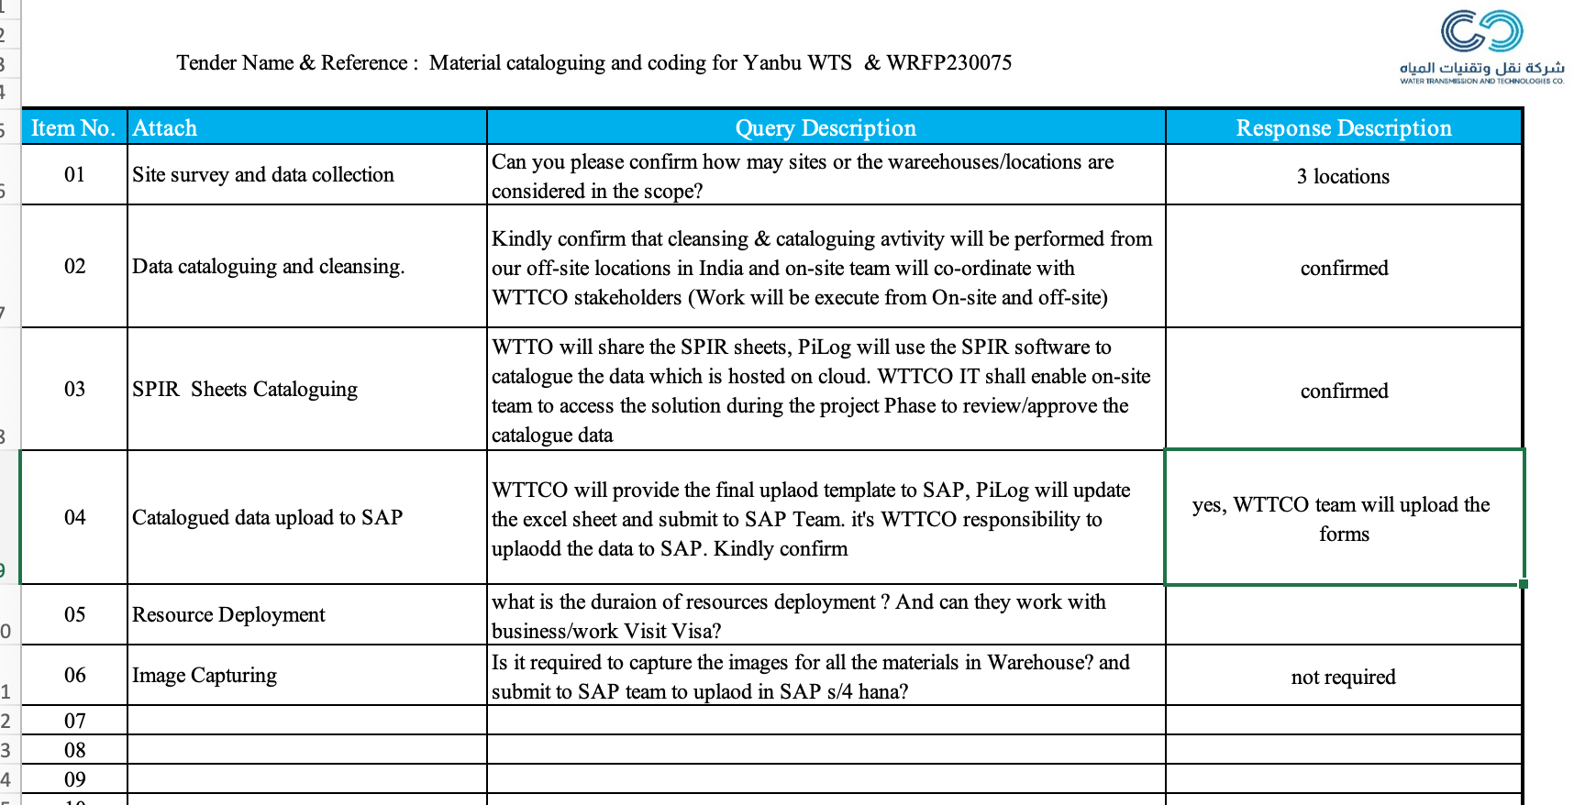
Addendum/Clarifications from WTTCCO

Slide 51
Question & Answers
Thank you
You are welcome to connect with us
E-mail: umar.Farooq@piloggroup.com
Website: www.piloggroup.com

